Slide 1

So they read distinctly from the book, in the Law of God; and they gave the sense, and helped them to understand the reading (Neh. 8:8).
All Scripture is taken from the New King James Version®. © 1982 by Thomas Nelson, Inc. Used by permission. All rights reserved.
Meaning-Based Translation

Slide 2


Literal vs. Meaning-Based Translation
Literal
Meaning-Based
Focus on restating each word in the source text, one by one
Focus on translating the message of the source text so that its meaning is understood

Slide 3
Oral Interpretation
Original
message
Target
language
Meaning
Accurate = Same Meaning
Clear = Easy to Understand
Natural = Conversational Flow

Slide 4
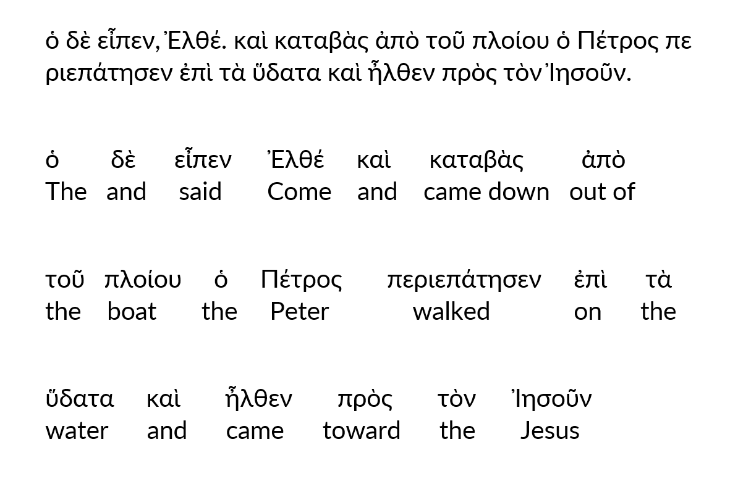
ὁ δὲ εἶπεν, Ἐλθέ. καὶ καταβὰς ἀπὸ τοῦ πλοίου ὁ Πέτρος περιεπάτησεν ἐπὶ τὰ ὕδατα καὶ ἦλθεν πρὸς τὸν Ἰησοῦν.

Slide 5
“I am very blessed to be here today.
By God’s grace and the power of the Holy Spirit, Scripture will be translated into our own tongue.”

